Slide 1

Know Thy Shelf
Team Name - Know Thy Shelf
Team No. - 2
Team Members | Roll No.
Harshpreet Singh | 2210990393
Harshit Singla | 2210990391
Harshit Kukreja | 2210990387
Ishika Gulati | 2210990423

Slide 2
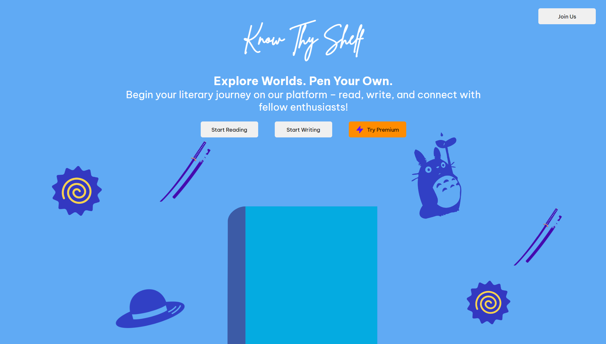
Introduction
Our goal is to create a website where people can enjoy lots of interesting stories in different genres.
They can read these stories as books or listen to them as audio books whenever they want.
Additionally, we strive to provide a uniquely beautiful user interface design that sets us apart from other book reading websites, enhancing the overall reading experience for our users.
It's a place for people who love books to share their own creative ideas with others.

Slide 3
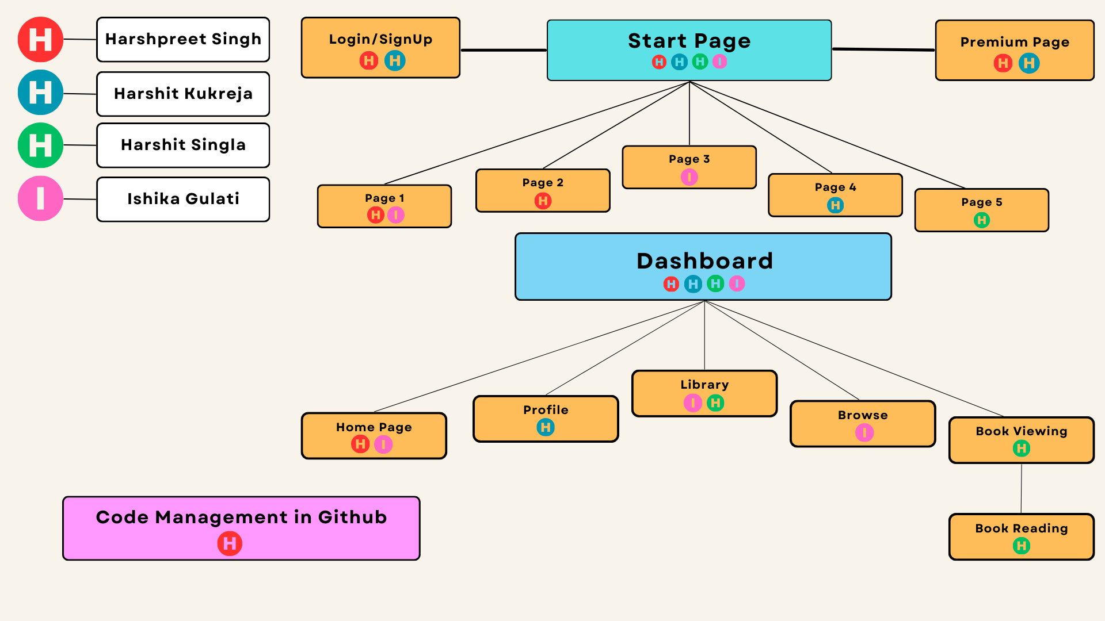
Methodology and Approach Used

Slide 4
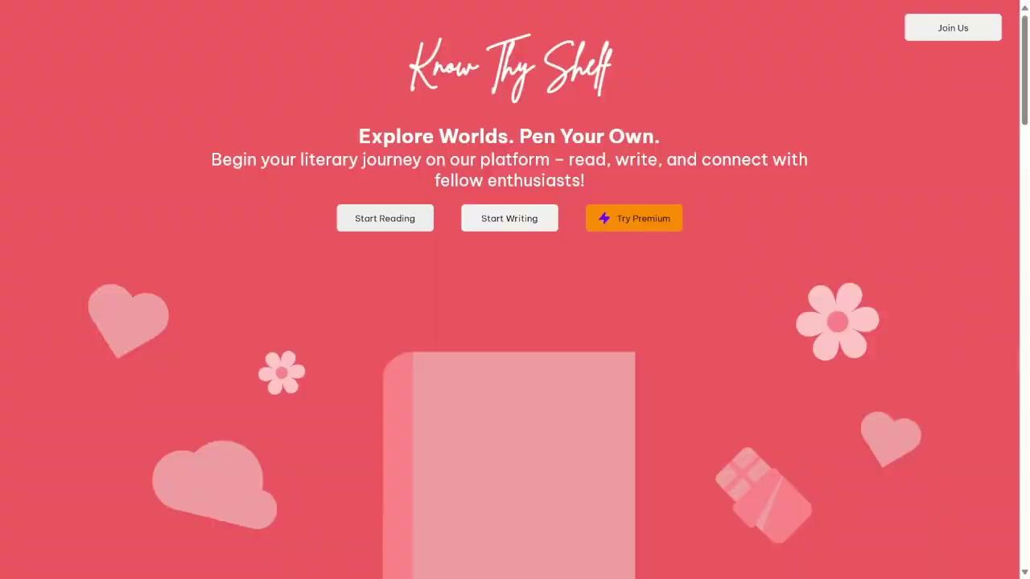
Landing Page
Interactive Sliders: Engage users with dynamic content presentation.
Immersive Page Flipping: Mimic real book flipping for an engaging experience.
Smooth Animations: Enhance user experience with seamless transitions.
Responsive Design: Ensures optimal viewing across devices and screen sizes.
Multi-Platform Compatibility: Works seamlessly on various browsers and devices.

Slide 5
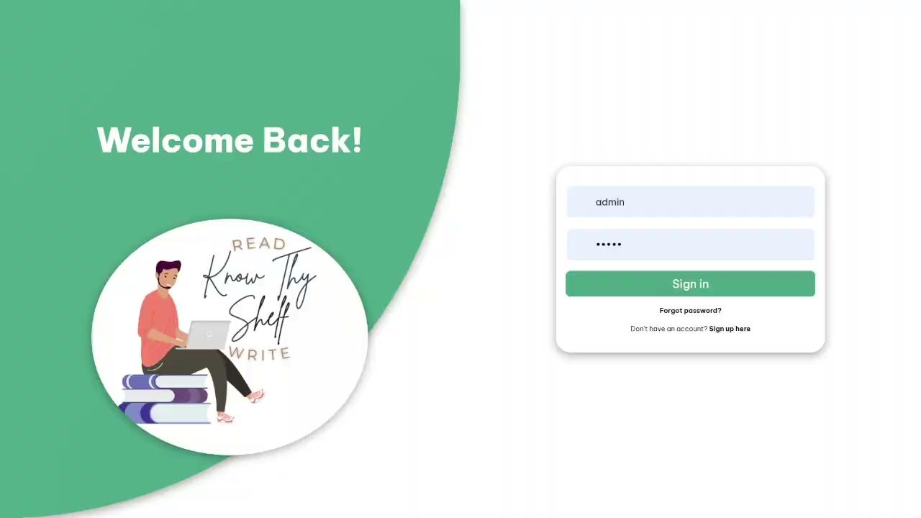
Authentication
Sign Up to Unlock Your Dashboard
Enter your credentials to access personalized features
Already a Member?
Sign in to continue your journey

Slide 6
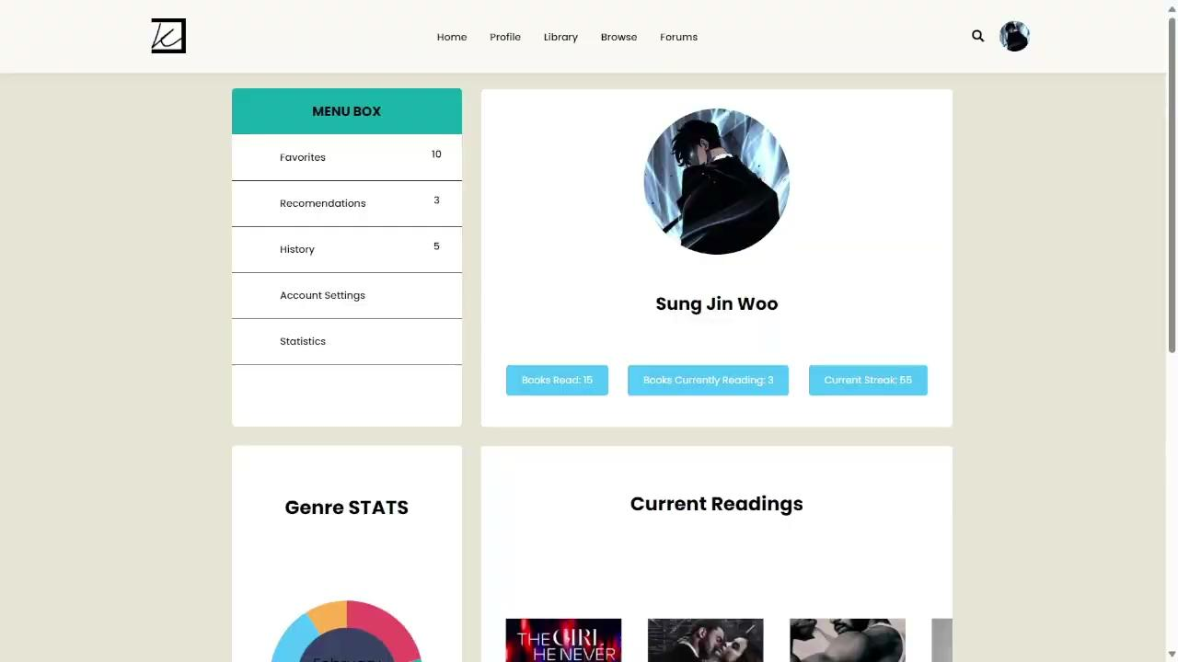
User Profile
Personal details and preferences to customize your reading experience
Insights into your reading habits.
Monitor your reading progress,
Celebrate milestones such as reading streaks, badges earned, and personal achievements.

Slide 7
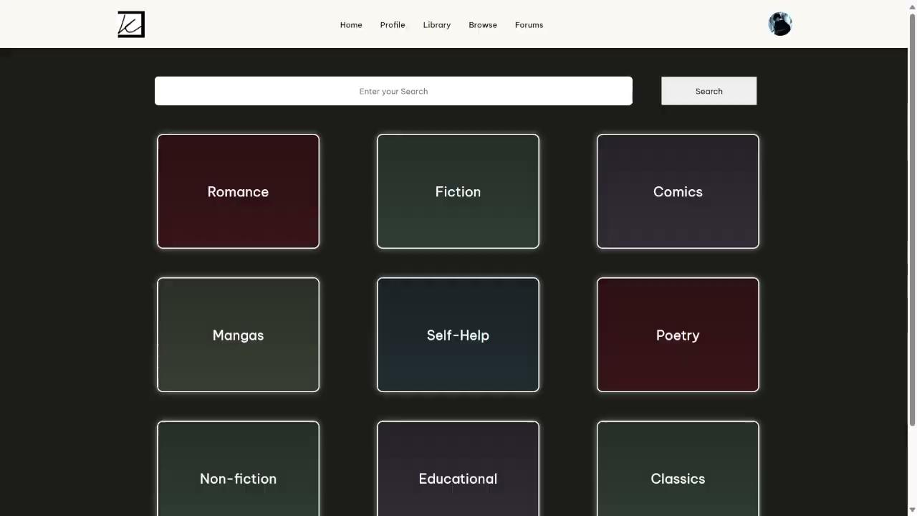
Browse Page
Entirely driven by DOM manipulation, our Browse Page offers dynamic content rendering for an immersive browsing experience.
Users can search for specific titles, authors, or genres with ease.
Leveraging the power of the Google Books API, users can effortlessly explore and access an extensive collection of books.
Customize your browsing experience with various filtering options.
Instant access to book details including synopsis, author information, and ratings.

Slide 8
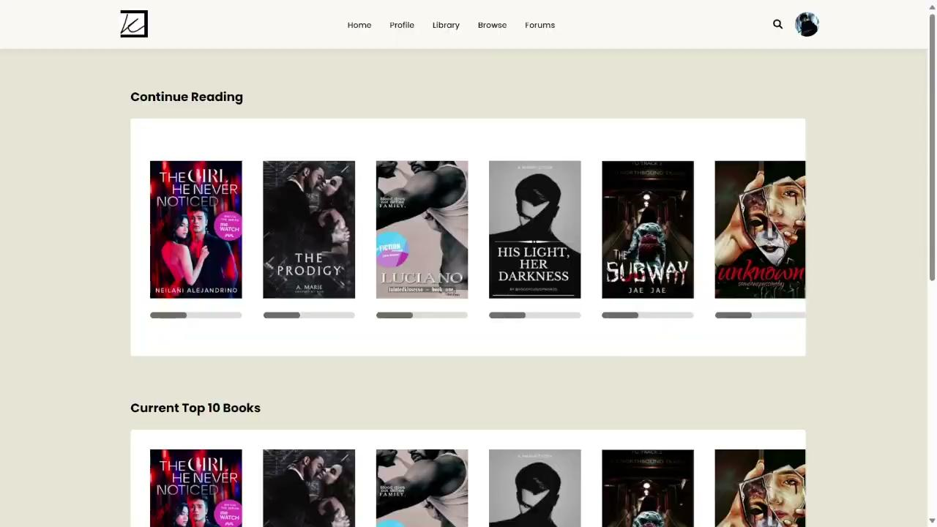
Library
Explore diverse topics, genres, and perspectives right at your fingertips.
Seamlessly connected to the vast resources of Google's database.
Instant access to information, summaries, and related content.
Dive into our library of a thousand books and embark on a limitless quest for knowledge.

Slide 9

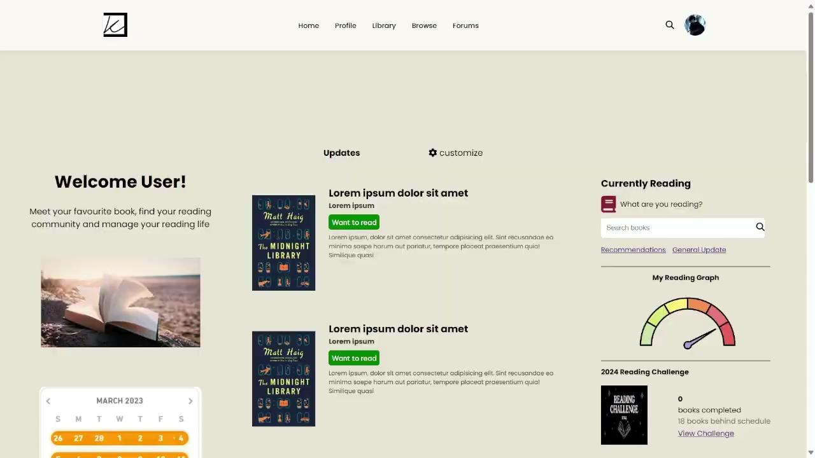
Dashboard
Instant updates about newly added books matching your preferences.
Track your reading progress, including pages read, books completed.
Monitor and celebrate consecutive days of reading using reading streaks.
Quick access to books you're currently reading,

Slide 10
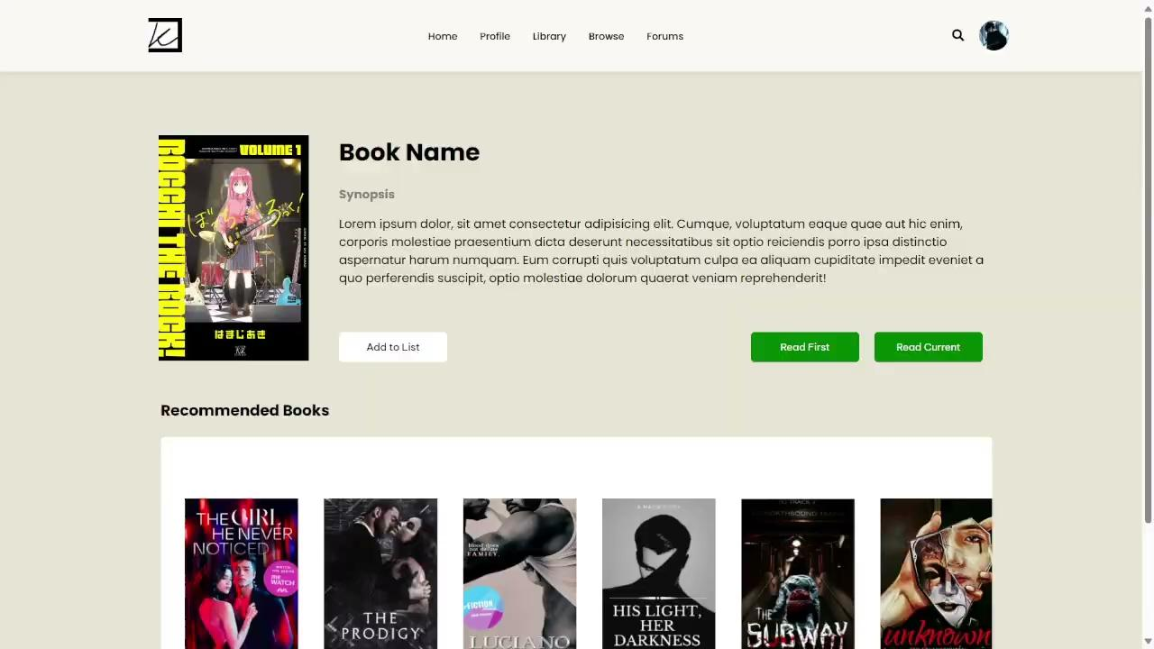
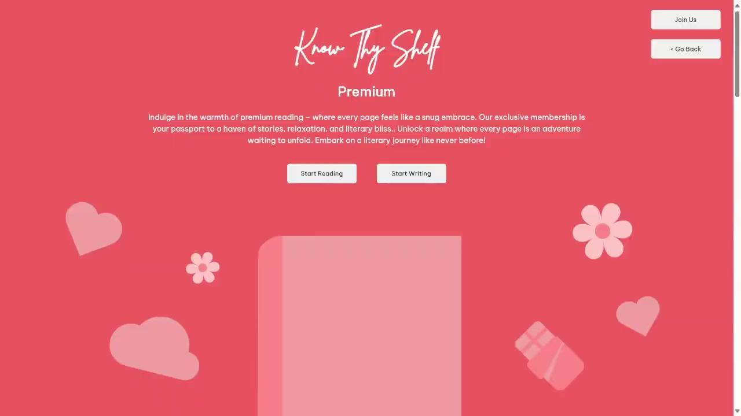
Premium & PDF Viewer
Seamlessly view and navigate PDF documents directly on our platform.
Elevate your browsing experience with our premium features

Slide 11
Future Scope
Write Your Own Book
Audio Book Integration
Translation in Multiple Languages
Daily Streak Rewards
Track Your Analytics

